Slide 1
Project on :
Crime Investigation Tracker with Suspect Prediction

Slide 2
Group Members :
Dev Vaidya [08]
Falguni Suryawanshi [15]
Sinnu Khankhure [21]
Pooja Lande [24]

Slide 3

Department of Computer Technology
Government Polytechnic Brahmapuri
[Affiliated to MSBTE, DTE Mumbai]
2021-2022

Slide 4
INDEX
1. | Rational
2. | Introduction
3. | Literature Survey
4. | Problem Identification
5. | Diagram
6. | Advantages and Disadvantages
7. | Future Work
8. | Resources Required
9. | Action Plan

Slide 5
1. Rational
Whenever a case against the crime is filed the investigation always starts from the scratch right away from the evidences found at the crime location and the eye witnesses present at the crime location. On the basis of the statement given by the eye witnesses about the crime and the criminal who committed that crime. The process of the investigations starts. As to reduce the stress of the police officers we implemented a system as criminal investigation tracker with suspect prediction that will help the officers to speed up the process of investigation and track status of ongoing case by predicting out the primary suspects on the basis of the records which consists of compendium of the people associated to the case, former criminal background proofs recovered from crime location, etc. This digitized system makes the work easy for an officer to check the status of the case online and even allows him to add up the new important information related to the case as it’s when needed. The proposed system consists of suspect prediction algorithm to predict and suggest the suspects in the logical order.

Slide 6
2. Introduction
We here propose a criminal investigation tracker system that tracks the investigation status of criminal cases with logs and also predicts primary suspects. The system is proposed to help agencies like CBI, CID and other such bureau’s to speed up investigation process and track status of multiple cases at a time. The system keeps logs of a case which includes case summary, people involved, disputes, past criminal history of those involved, Items recovered on scene and other details. The system realizes the type of case, allows admin to update the status of investigation, upload more images of crime, items found on scene etc. This allows authorized officers to check case status and look into its status online and also update any important info as and when needed. The system also consists of a suspect prediction algorithm. Based on type of case, property, land, love or other entities involved the system studies past cases, it studies past criminal records of those involved and based on this data it provides suggestions of suspected persons in a logical order. The system is designed to aid investigation teams to work collectively on cases, coordinate and also speed up the process by suggesting logical suspects based on data provided.

Slide 7
3. Literature Survey
This Literature review section reviews the previous significant literature which describes how this proposed system relates to existing researches and existing systems. This Literature review creates a link between this proposed system and existing systems. The literature review also highlights the key features, pros, and cons of that has been already well established and concluded systems as well as already published research papers, journals, and articles about the Criminal Records Management System and Criminal Investigation Tracker with suspect prediction algorithm

Slide 8
4. Problem Identification
His aim of this paper is to explore the problems in the existing criminal investigation systems and criminal record management systems to come up with perfect solutions for those problems. Nowadays each and everything is getting computerized. non-computerized criminal investigation and criminal management methods need skilled man-power and a lot of paperwork. It is quite hard to refer to previous crime details from non-computerized criminal records storing methods. There can be lost criminal records when using non-computerized methods to store criminal records. To avoid all these problems there are many systems that exist like mobile applications, web applications. Most existing systems do not have the capacity to manage tons of thousands of criminal records and some systems are not up to date. When we compare criminal investigation tracking systems various techniques and technologies are used to build criminal investigation tracking systems

Slide 9
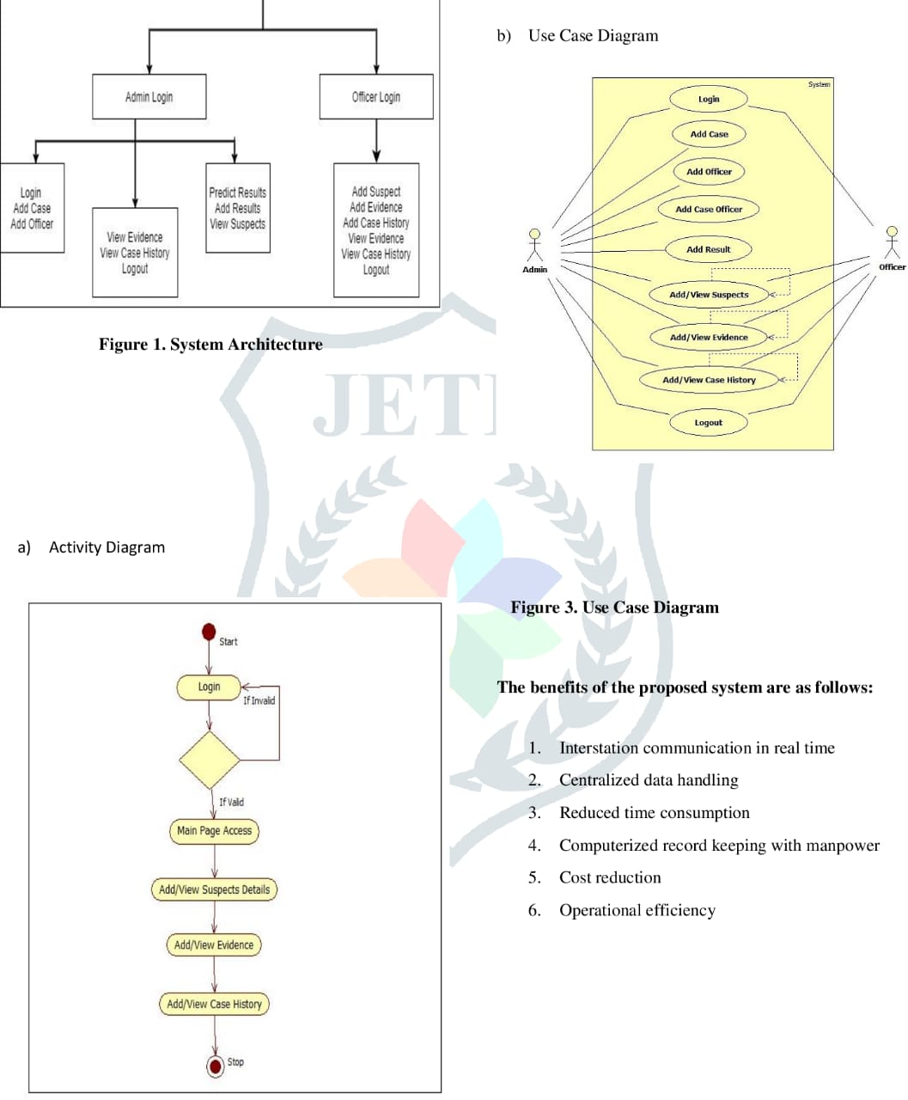
5. Diagram

Slide 10
6. Advantages & Disadvantages
Advantages
Disadvantages
The software will be very useful for government agencies.
The software allows for team work on solving complicated cases.
Will help in solving cases faster and efficiently.
The system needs a good online server for working efficiently.
If the server gets crash by any virus or Trojan all data will be leaked.

Slide 11
7. Future Work
Further study of this area will increase the accuracy and effectiveness of systems that have existed in law enforcement agencies. In the end, In order to overcome the limitations previously mention in this paper, we proposed to enhance the features of existing systems.

Slide 12
8. Resources Required
Hardware Requirements
Processor: Dual core or above
RAM: 4 GB or higher
Hard Disk: 500GB SSD
Software Requirements
Operating System: Microsoft Windows
Client-side technology: HTML, JavaScript.

Slide 13
9. Action Plan
Sr. No. | Detail of Activity | Planned Start Date | Planned Finish Date | Name of Responsible Team Members
1] | Discuss topic
2] | Information search from various resources
3] | Implementation
4] | Corrections

